Slide 1
Foundations of Data Science Summer 2022 orientation

Slide 2
Course information
Instructors
Yao Li (liyao@umass.edu) and Yulong Lu (yulonglu@umass.edu)
Recitation/Group Project
Brian Van Koten (bvankoten@umass.edu) and Haben Michael (hmichael@umass.edu)
Teaching assistants
Shai He (she@umass.edu) and Harsh Dubey (dubey@math.umass.edu)
Course website on Moodle
Lectures, labs and office hours are all hold on zoom. Zoom links and recorded meetings can be found on the Moodle site.
Grades are based on the attendance of lectures and labs, homework and the final project.

Slide 3
Course schedule
Week 1 Monday: Lecture 1 9:30-11:00, Lab 1 2:30-3:30 Tuesday: Lecture 2 9:30-11:00, Lab 2 2:30-3:30, HW 1 assigned after lecture Wednesday: Group office hour 1 9:00-11:30, Instructor office hour 1: 1:00-2:00 Thursday: Lecture 3 9:30-11:00, Lab 3 2:30-3:30 Friday: Lecture 4 9:30-11:00, Lab4 1:00-2:00, Group office hour 2 2:30-5:00, HW 2 assigned after lecture
Week 2 Monday: Lecture 5 9:30-11:00, Lab 5 1:00-2:00, Group office hour 3 2:30-5:00 Tuesday: Lecture 6 9:30-11:00, Lab 6 2:30-3:30, HW 3 assigned after lecture Wednesday: Group office hour 4 9:00-11:30, Instructor office hour 2: 1:00-2:00, Lab 7 2:30-3:30 Thursday: Lecture 7 9:30-11:00, Lab 8 2:30-3:30 Friday: Lecture 8 9:30-11:00, Final group presentation 1:30-3:30

Slide 4
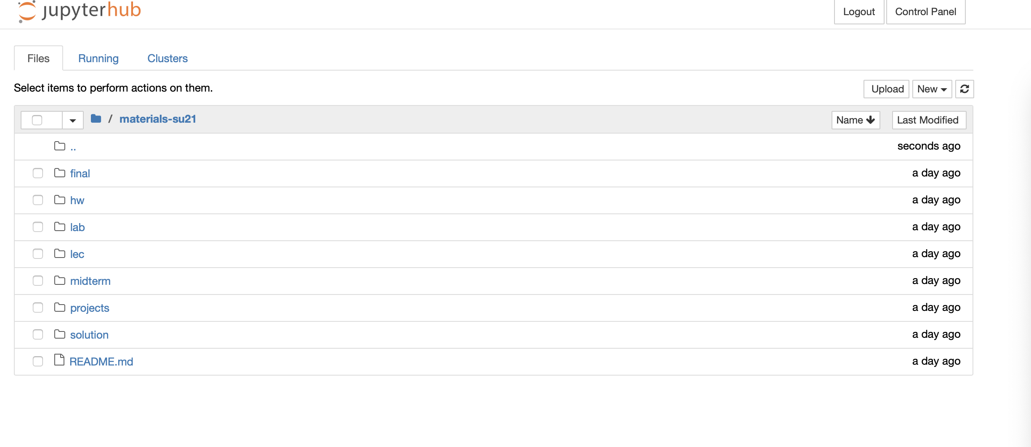
Course infrastructure
Jupyterhub at http://datahub2.cs.umass.edu/user/username/tree/materials-su22

Slide 5
Course Highlights
Textbook: Computational and Inferential Thinking
https://inferentialthinking.com/chapters/01/1/intro.html
Eight lectures on Foundations of Data Science with emphasis on
Python-based simulation
Data management
Probabilistic and statistical reasoning
Practical examples
Project
Project group forming by Tuesday of the first week. Each group has 3-4 students.
Nine projects from the instructor team.
Depending on the interests, new projects may be developed by some groups under the guidance of Brian and Haben in the group office hours.
Final project presentation will take place on Friday of the second week.

Slide 6
Questions?

